Slide 1
Credit EDA ANALYSIS
Risk management
B Nikhil

Slide 2
Agenda
Credit Risk Analysis – Problem statement
Assumptions
Approach
Recommendations based on Analysis

Slide 3
Problem statement
Risk analytics is key to determine company’s progress by analyzing the potential risks involved in the decision making in-order to withstand for long term in the market and gain sustainable profits.
This case study identifies the risks involved in financial and banking services while granting loans with the intention to keep check on loan defaults through various key driving factors.

Slide 4
Assumptions
Based on the Risk analytics, its good to have few assumptions before going in-depth analysis with the dataset.
a. Financial institutes should monitor the documents carefully which states on monthly income, age group, rented/own house, previous credit history, married/unmarried, occupation type.
b. Previous approved customer or newly applied customers. If previous approved customers, get a basic check on their on-time loan repayment.

Slide 5
Approach on EDA
Understand the business scenario and problem statement.
Inspecting the data.
Data cleaning and analysis
Insights / conclusion

Slide 6
Dataset understanding.
There are two datasets:
a. ‘application_data.csv' : Contains the information of the client at the time of application which gives on various factors to know if any client has payment difficulties.
b. ‘previous_application.csv’ : Contains information of the clients previous loan history. Which can be utilised to predict the type of customers having loan payment difficulties based on various factors.
c. There is unique column which can be used to merge previous_application dataset with current application_data i,e ‘SK_ID_CURR’ .
d. Target variable with ‘1’ determines if clients have payment difficulties and with ‘0’ - other cases.

Slide 7
Data cleaning and analysis
Verify the columns, datatypes, key factors that can be utilised for analysis.
Treating the missing values:
a. Percentage of missing values in the dataset are higher. Hence need to deal carefully in- order to reduce anomalies and wrong assumptions. Removed 2 columns with too higher missing data which doesn’t give much insights and other 2 rows with too lower percentages and remaining columns based on analysis in the dataset. Few columns with statistical approach using mean and mode.
b. Created new dataframe for numerical datatypes columns to analyze and separate for categorical analysis.
c. Outliers are handled for important fields using box plot and quantile percentages.

Slide 8
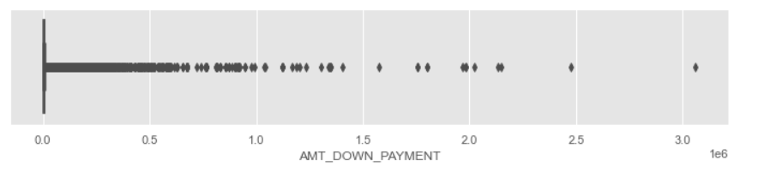
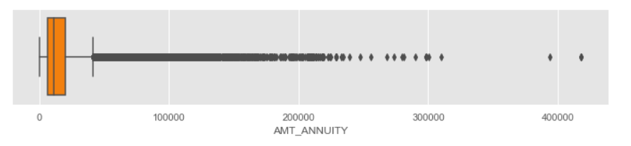
Outliers:

Slide 9
Two new columns [‘AGE GROUP’, ‘Income category’] has been appended to the dataset for categorical data analysis.
‘AGE’ column has been created to remove negative values in ‘DAYS_BIRTH’ and convert it to respective age of person.

Slide 10
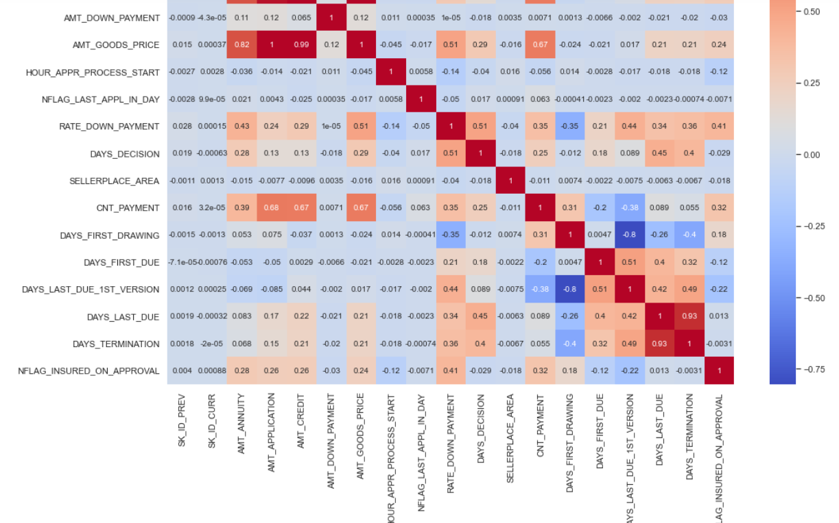
Heat maps:

Slide 11
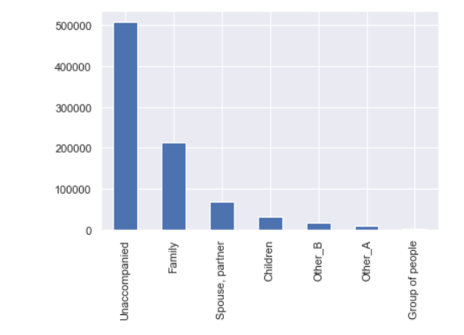
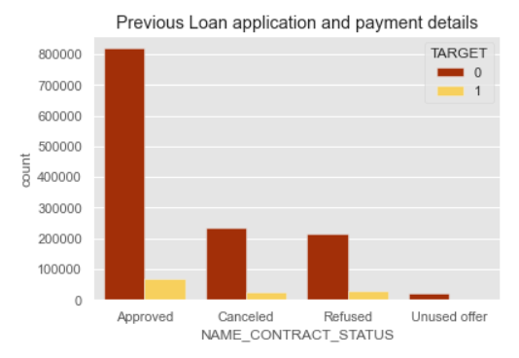
Data ANALYSIS:
Percentage of defaulters is less as per datasets (approx. 8%)
People with unaccompanied has greater percentage of loans followed by family.
Percentage of approved loans without defaults have larger values.

Slide 12
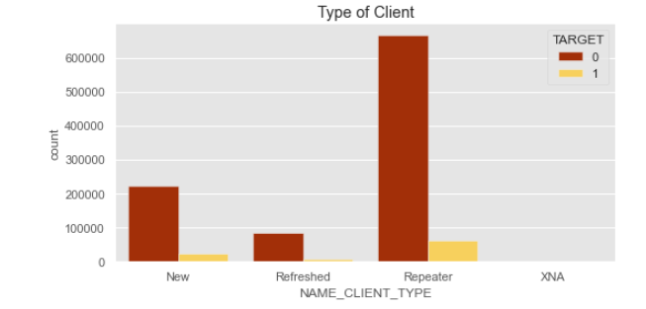
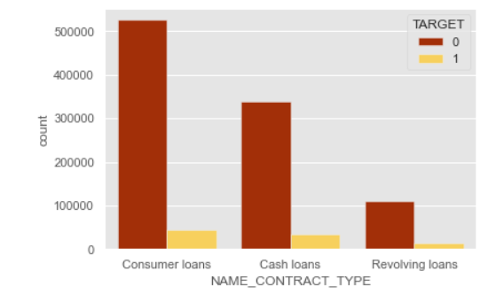
Analysis :
Majority of loan applicants are previously applied customers.
Higher number of loans are applied for consumer loans.

Slide 13
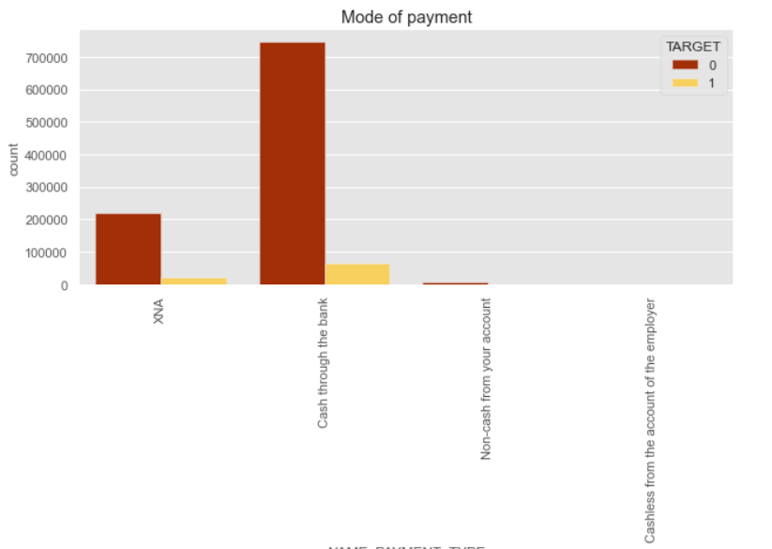
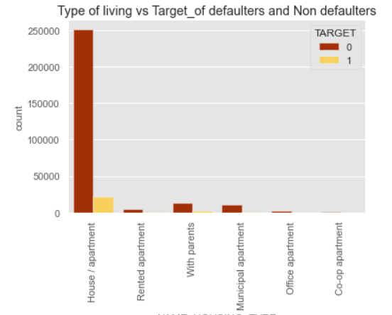
Analysis:
Most widely used loan repayment method is through Cash.
People with House/apartment have taken greater percentage of loans and have quite comparative percentage of defaulters with other type of housing.

Slide 14
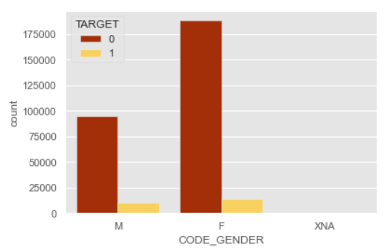
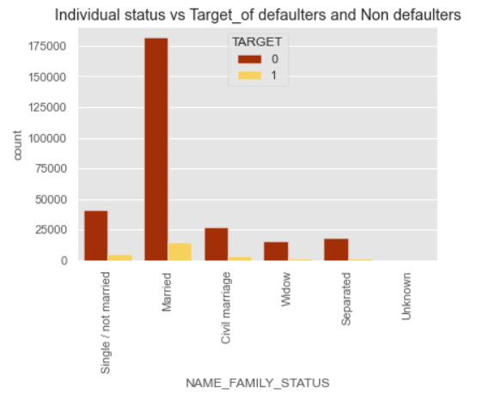
Analysis:
Married people have taken more percentage of loans and defaulters are more in married status applications compared to other status.
Females loan applications are more than men and with default of approx. 55%

Slide 15
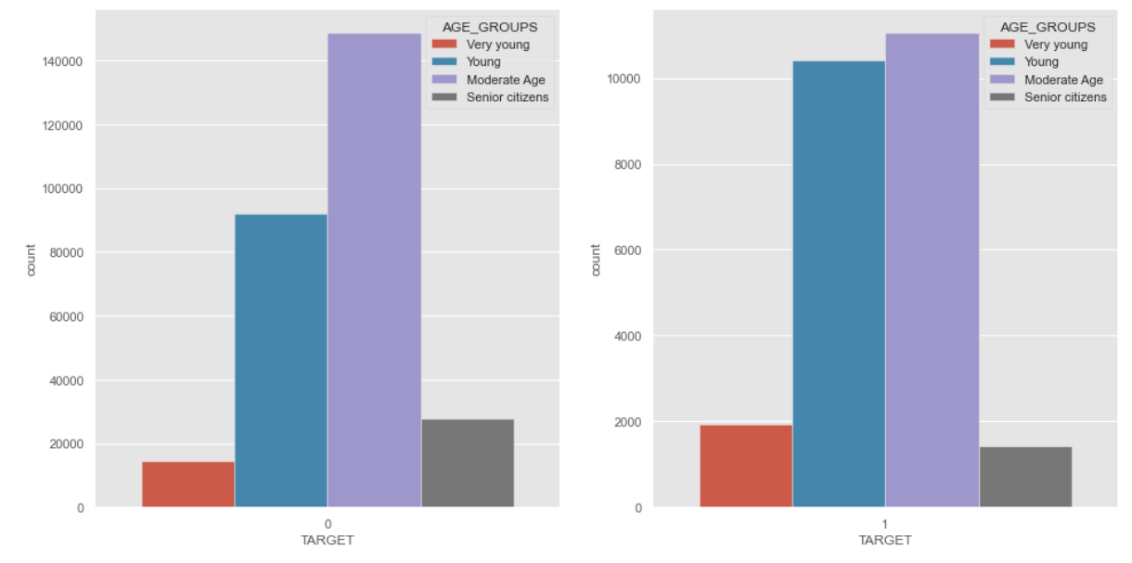
Analysis:
People with moderate age ranging from (39-60) have taken more number of loans.
People with Young age ranging between (25-38) have more difficulty in paying loans as per percentage of number applied loans and target.

Slide 16
Conclusion:
Percentage of previously refused loans which have non defaulted in current loan applications are around 80%. Hence its required to check on the customers before cancelling the applications.
As part of analysis, its quite insistible to lend loans to senior citizens, widows and applications coming through car dealers.
People with Insurance, labourers, rented apartments, living with parents and family have high risk of defaults. Hence based on age group and annual income, loans brackets and interest rates can be made to reduce the risk.
Male applicants with incomplete education/lower education have high risk of defaults.

